Slide 1
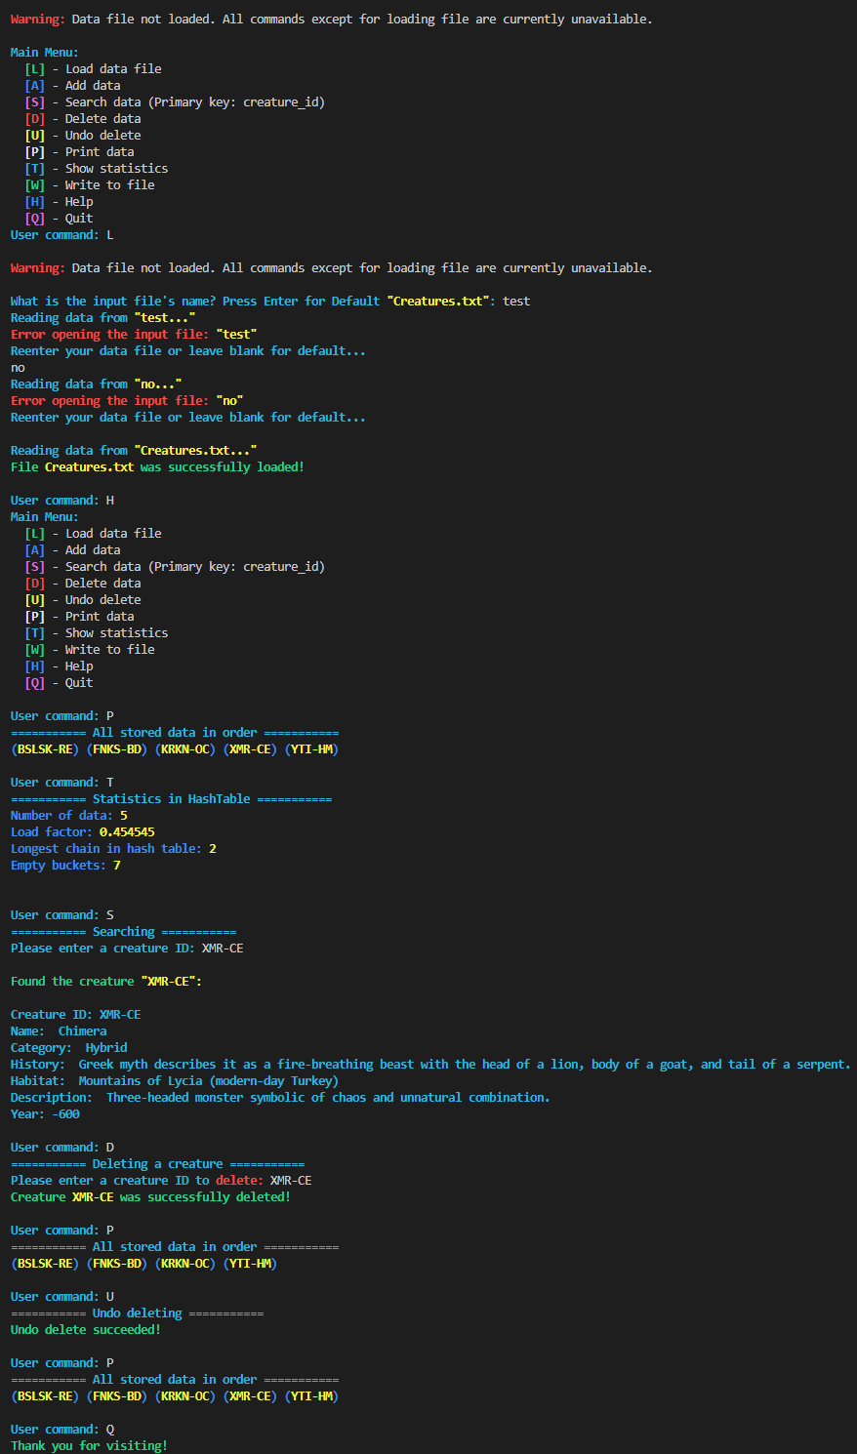
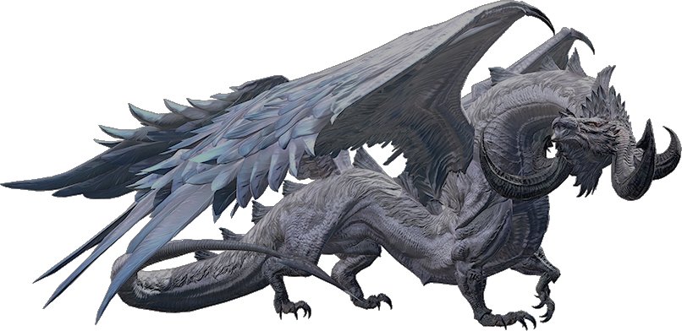
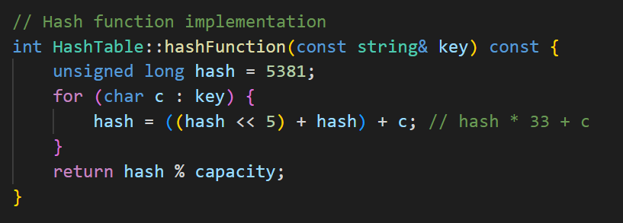
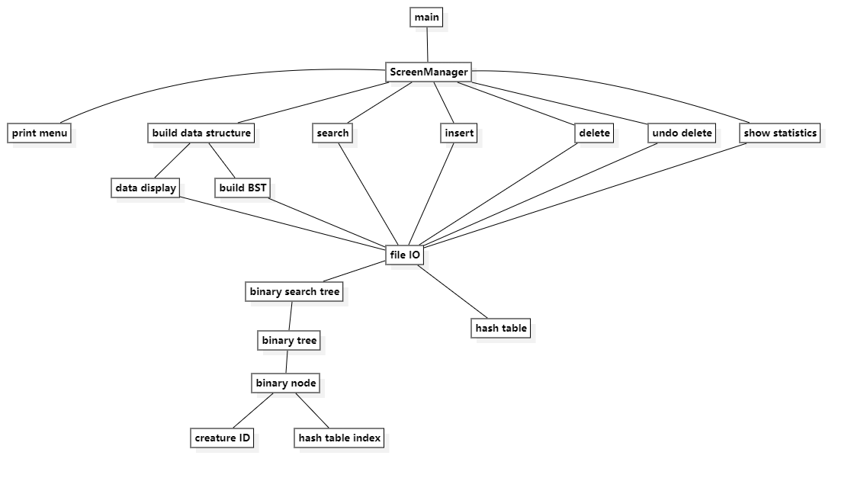
Mythical Creature Catalog
Sample Run:
Application Data: Creature
Creature ID (String) – Primary Key, abbreviated name – abbreviated creature type, e.g. FNKS-BD
Name (String) – Full name of creature
Category (String) – Type of creature, e.g. Bird
History (String) – Famous Legend/Myth
Habitat (String) – where the creature lives
Description (String) – standout characteristics
Relevant Year (Integer) – year of first mention/came to relevancy
Team Members: Shunyao Jin, Leyan Pan, Zachary Rudin, Ye Zhang
Hash function:
Structure Chart

Slide 2
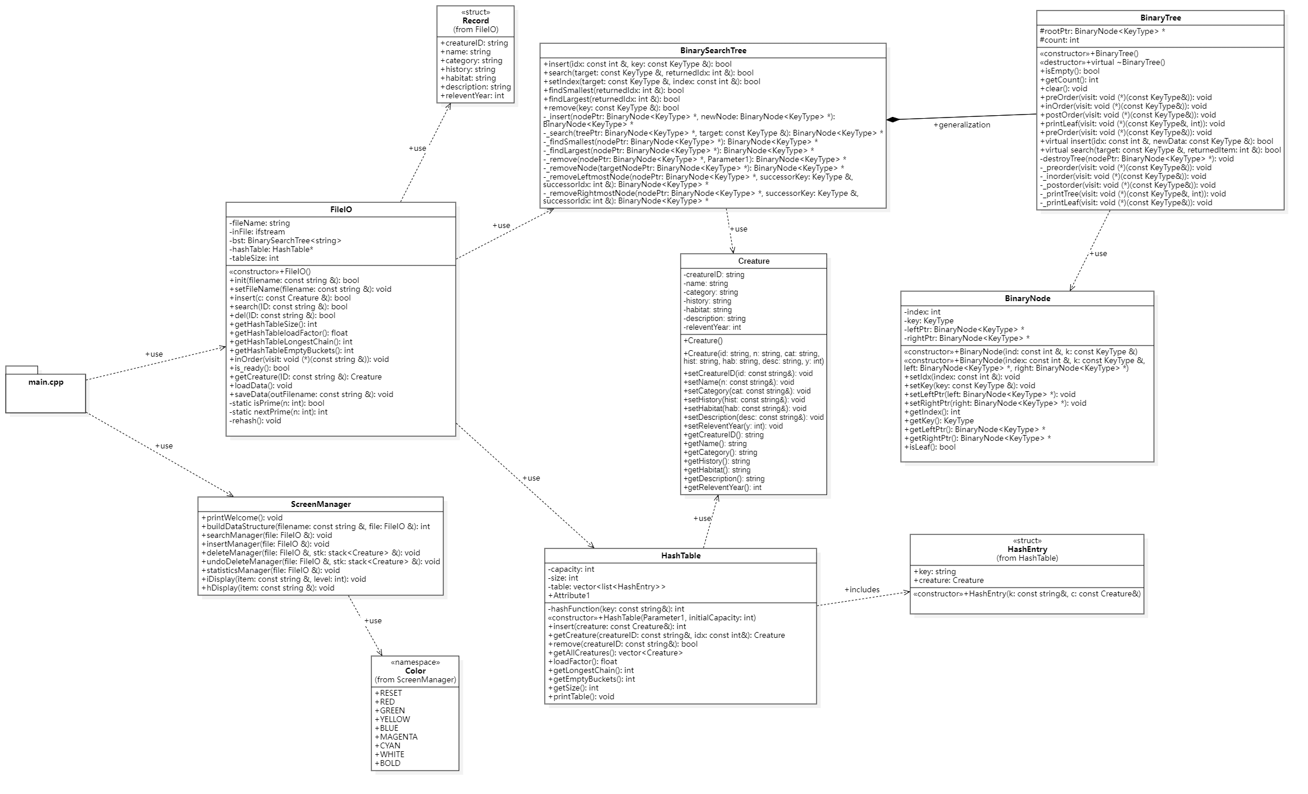
UML diagram

